Slide 1

8th Grade Math: Pre-Algebra
Unit 7, Lesson 5 Graphing Lines for Real-World Contexts Volume 1, pg. 305

Slide 2


Benchmark
MA.8.AR.3.4
Given a mathematical or real-world context, graph a two-variable linear equation from a written description, a table, or an equation in slope-intercept form.
volume 1, pg. 305

Slide 3
Integrated Mathematical Thinking and Reasoning Standards
MA.K12.MTR.5.1 Use patterns and structure to help understand and connect mathematical concepts.
MA.K12.MTR.7.1 Apply mathematics to real-world contexts.
volume 1, pg. 305

Slide 4

Learning Target
I can graph a two-variable linear equation from an equation, table, or written description given a real-world context.
volume 1, pg. 305

Slide 5

Warm-Up
volume 1, pg. 305

Slide 6
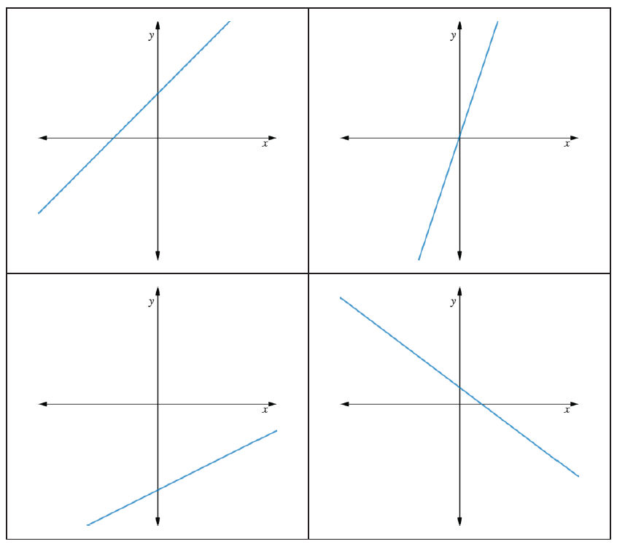
7.5.1 Warm-Up: Which One Doesn’t Belong?
The graphs of four linear relationships are shown.
Circle the graph that doesn’t belong. Explain your reasoning.
volume 1, pg. 305

Slide 7

Exploration
volume 1, pg. 306

Slide 8

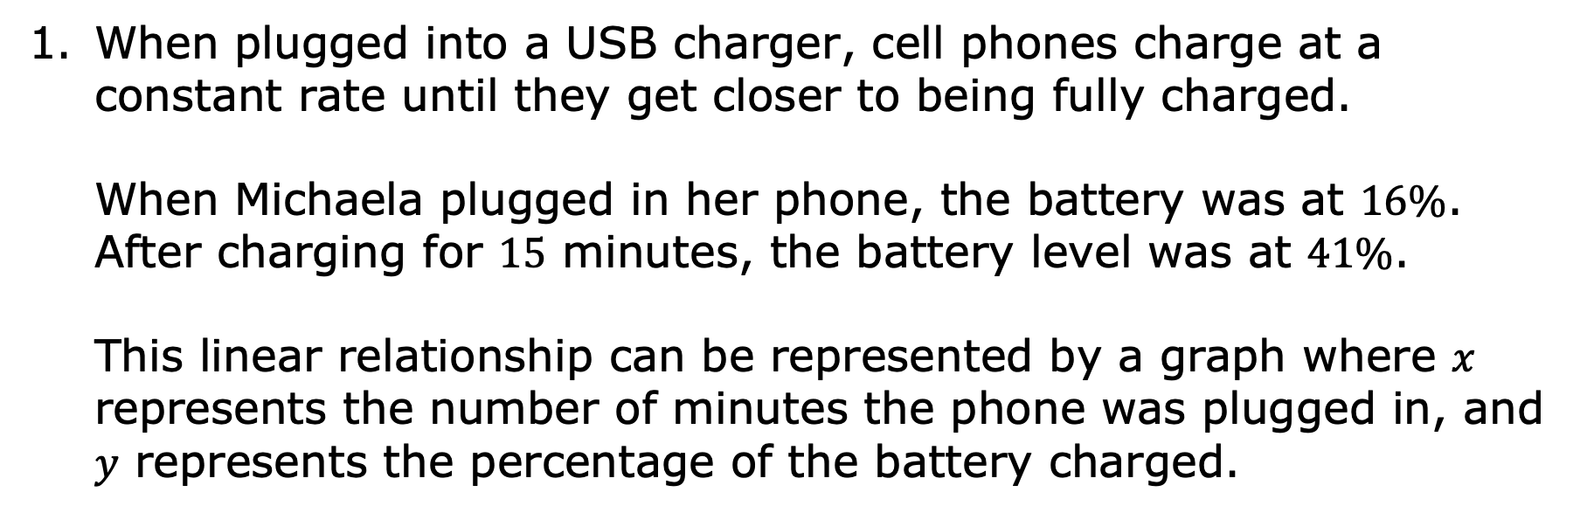
7.5.2 Exploration: Graphing Linear Relationships for Real-World Contexts
When plugged into a USB charger, cell phones charge at a constant rate until they get closer to being fully charged. When Michaela plugged in her phone, the battery was at $16\%$. After charging for $15$ minutes, the battery level was at $41\%$. This linear relationship can be represented by a graph where $x$ represents the number of minutes the phone was plugged in, and $y$ represents the percentage of the battery charged.
volume 1, pg. 306

Slide 9
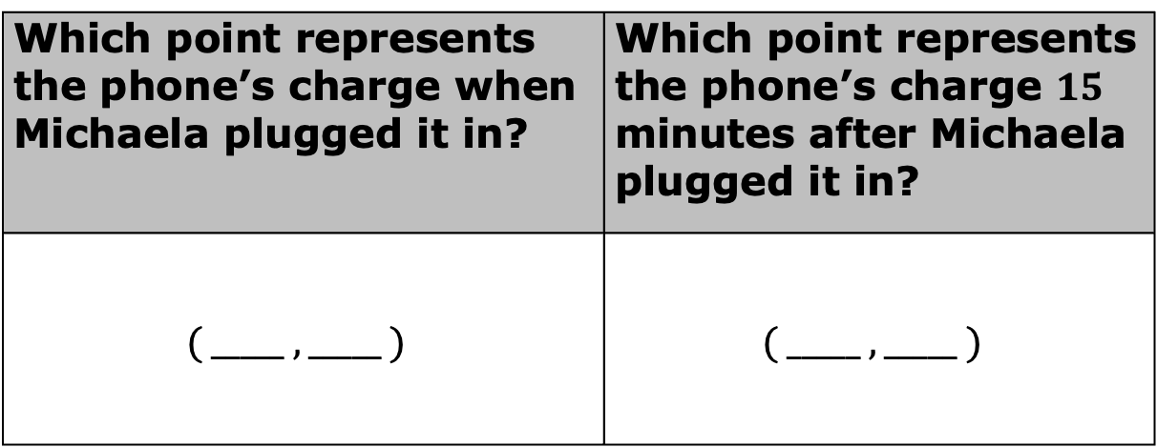
Harry said there is enough information from this context to find two points on the graph of this relationship.
Work with your partner to determine the coordinates of the two points.
Which point represents the phone’s charge when Michaela plugged it in? | Which point represents the phone’s charge $15$ minutes after Michaela plugged it in?
$$( _____ , _____ )$$ | $$( _____ , _____ )$$
volume 1, pg. 306

Slide 10
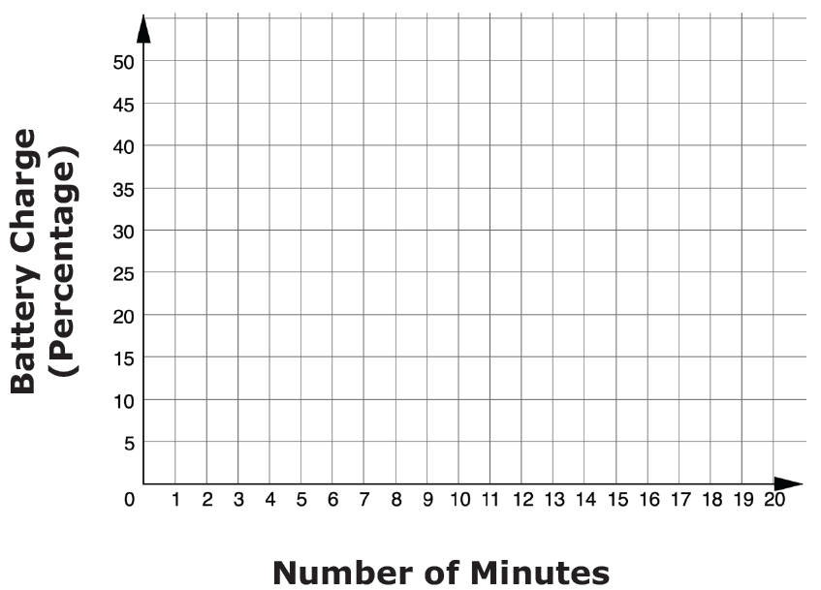
Graph the linear relationship.
What information was used to graph the relationship?
volume 1, pg. 306

Slide 11
Explain why the slope was not needed to graph this relationship.
volume 1, pg. 306

Slide 12
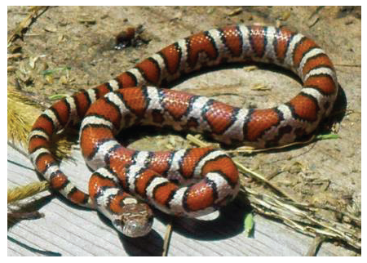
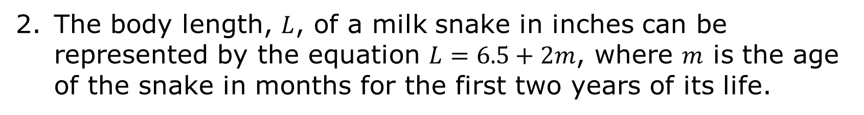
The body length, $L$, of a milk snake in inches can be represented by the equation $L=6.5+2m$, where $m$ is the age of the snake in months for the first two years of its life.
volume 1, pg. 307

Slide 13
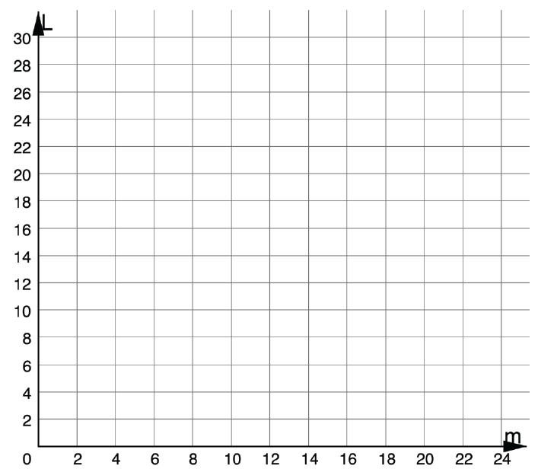

Graph the relationship between $L$ and $m$.
volume 1, pg. 307

Slide 14
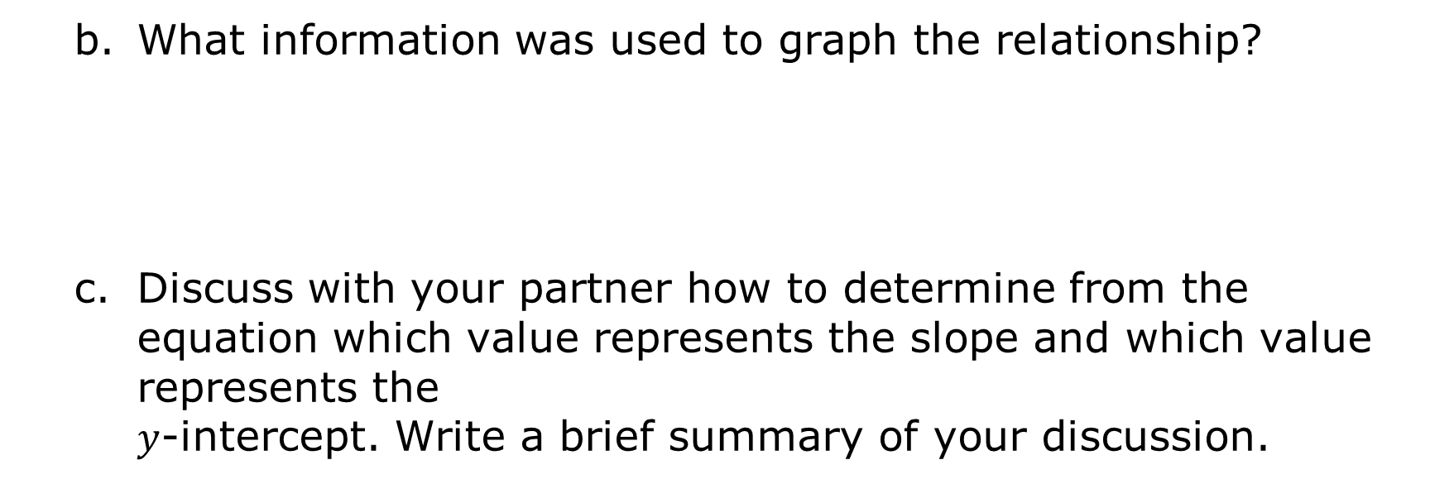
What information was used to graph the relationship?
Discuss with your partner how to determine from the equation which value represents the slope and which value represents the $y$-intercept. Write a brief summary of your discussion.
volume 1, pg. 307

Slide 15

Bring It Together
volume 1, pg. 307

Slide 16

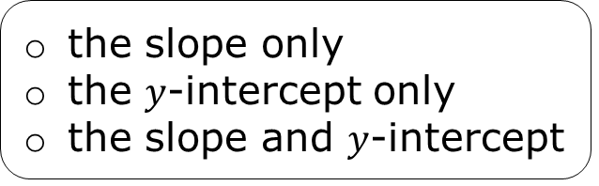
7.5.3 Bring It Together: Graphing Relationships from Real-World Contexts
For each context, different information was used to graph the linear relationships.
To graph a linear relationship given a real-world context, the information that is necessary to know is either or
the slope only
the $y$-intercept only
the slope and $y$-intercept
two ordered pairs.
a table of values with five ordered pairs.
volume 1, pg. 307

Slide 17

Guided Practice
volume 1, pg. 308

Slide 18

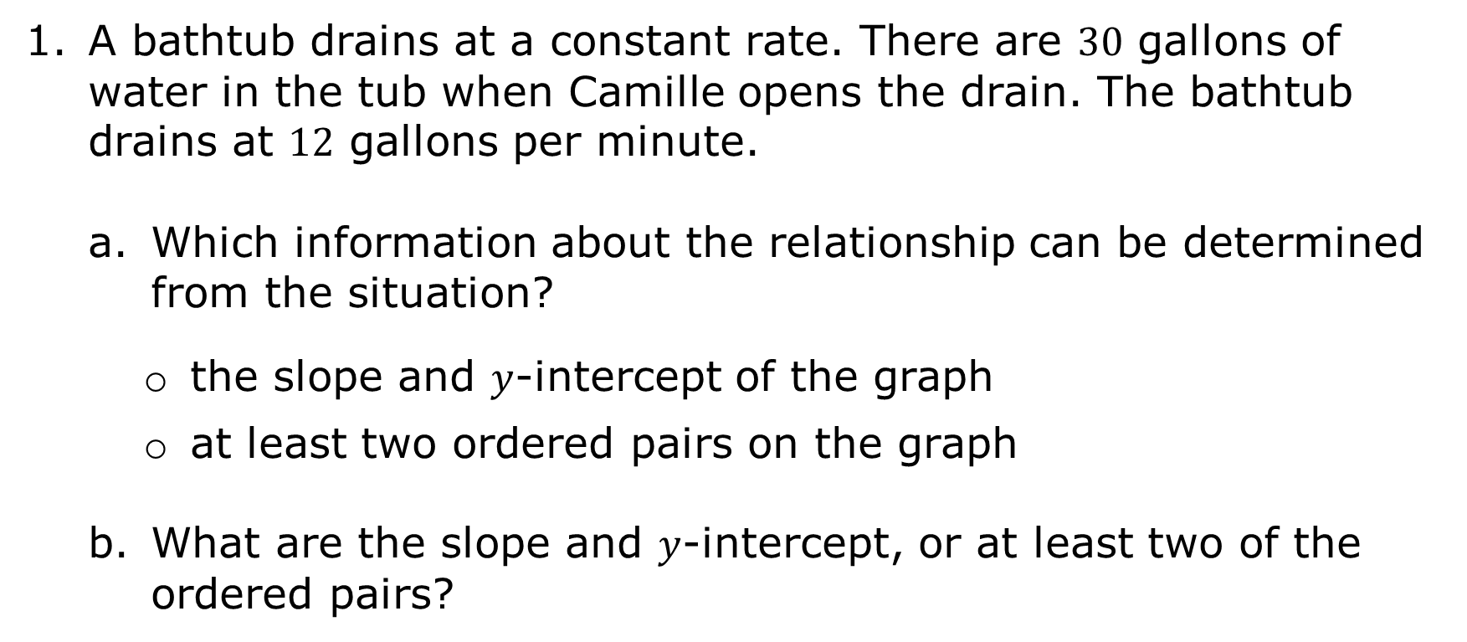
7.5.4 Guided Practice: Graphing Linear Relationships for Real-World Contexts
A bathtub drains at a constant rate. There are $30$ gallons of water in the tub when Camille opens the drain. The bathtub drains at $12$ gallons per minute.
Which information about the relationship can be determined from the situation?
the slope and $y$-intercept of the graph
at least two ordered pairs on the graph
What are the slope and $y$-intercept, or at least two of the ordered pairs?
volume 1, pg. 308

Slide 19
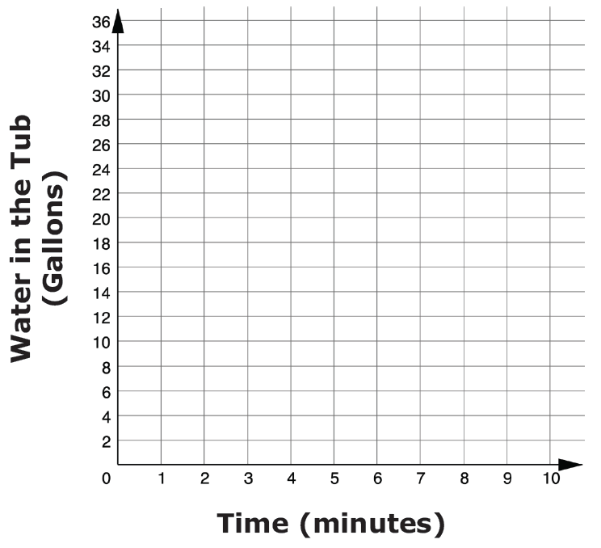
Graph the linear relationship between time, in minutes, $x$, and the number of gallons in the bathtub, $y$.
volume 1, pg. 308

Slide 20
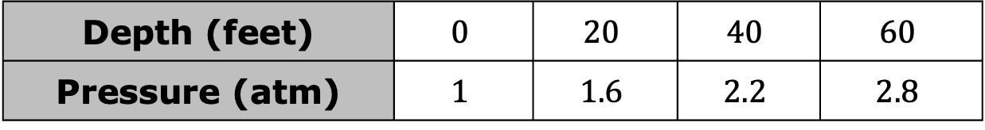
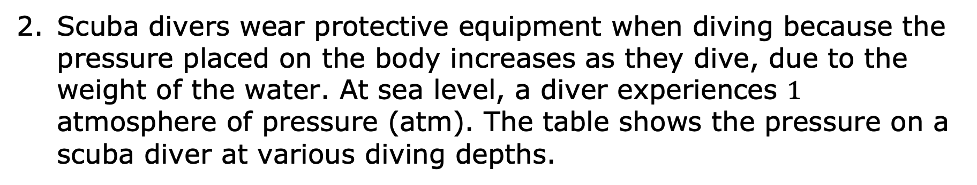
Scuba divers wear protective equipment when diving because the pressure placed on the body increases as they dive, due to the weight of the water. At sea level, a diver experiences $1$ atmosphere of pressure (atm). The table shows the pressure on a scuba diver at various diving depths.
Depth (feet) | $$0$$ | $$20$$ | $$40$$ | $$60$$
Pressure (atm) | $$1$$ | $$1.6$$ | $$2.2$$ | $$2.8$$
volume 1, pg. 308

Slide 21
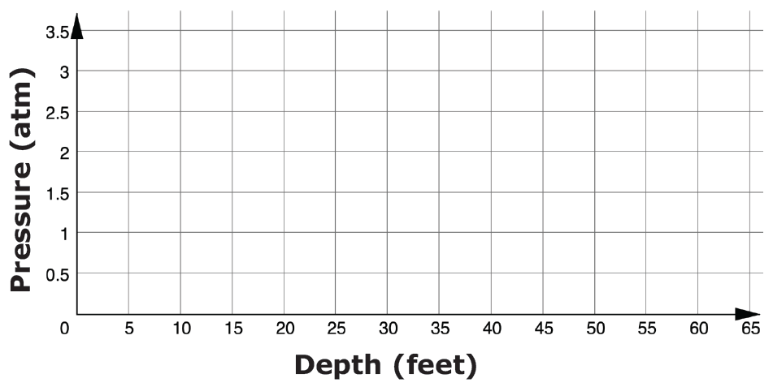

Graph the linear relationship between depth in feet, $x$, and pressure, in number of atmospheres of pressure (atm), exerted on the diver, $y$.
What is the slope of the line?
volume 1, pg. 308

Slide 22

Your Turn
volume 1, pg. 309

Slide 23
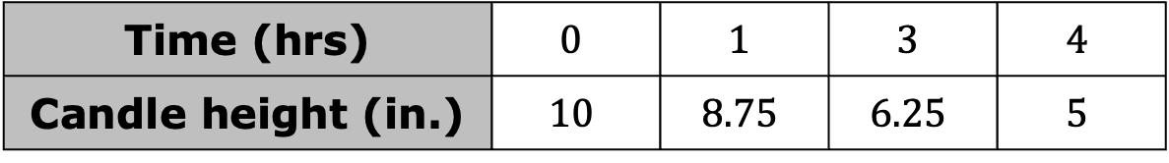
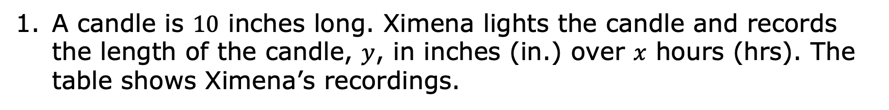
7.5.5 Your Turn!
A candle is $10$ inches long. Ximena lights the candle and records the length of the candle, $y$, in inches (in.) over $x$ hours (hrs). The table shows Ximena’s recordings.
Time (hrs) | $$0$$ | $$1$$ | $$3$$ | $$4$$
Candle height (in.) | $$10$$ | $$8.75$$ | $$6.25$$ | $$5$$
volume 1, pg. 309

Slide 24
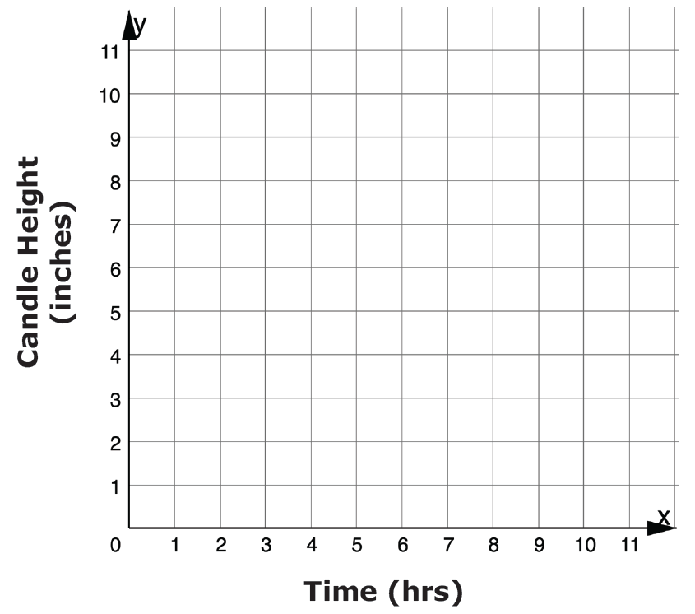
Graph the relationship between candle height and time.
volume 1, pg. 309

Slide 25
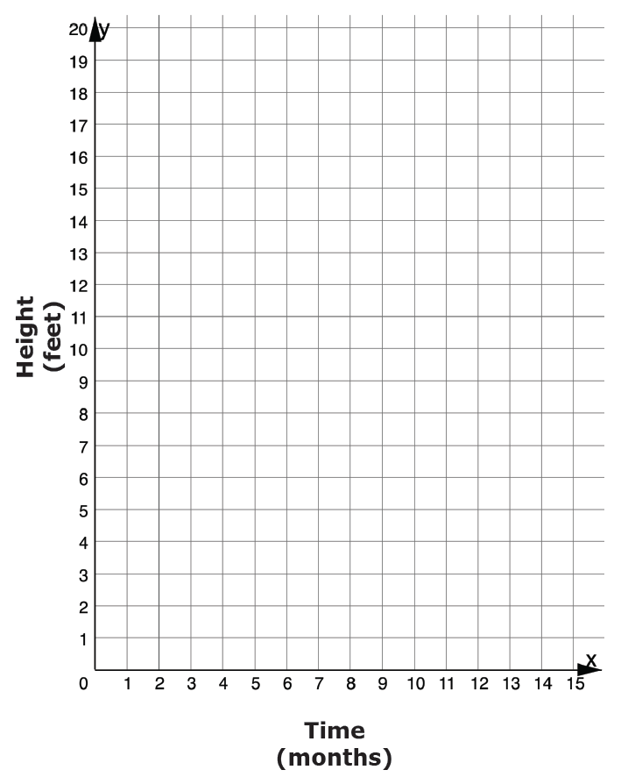
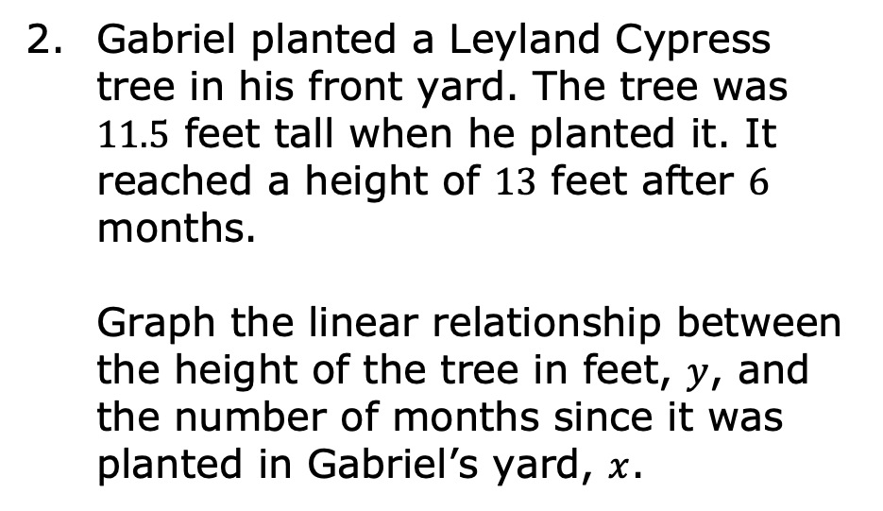
Gabriel planted a Leyland Cypress tree in his front yard. The tree was $11.5$ feet tall when he planted it. It reached a height of $13$ feet after $6$ months. Graph the linear relationship between the height of the tree in feet, $y$, and the number of months since it was planted in Gabriel’s yard, $x$.
volume 1, pg. 309

Slide 26

Wrap-Up
volume 1, pg. 310

Slide 27
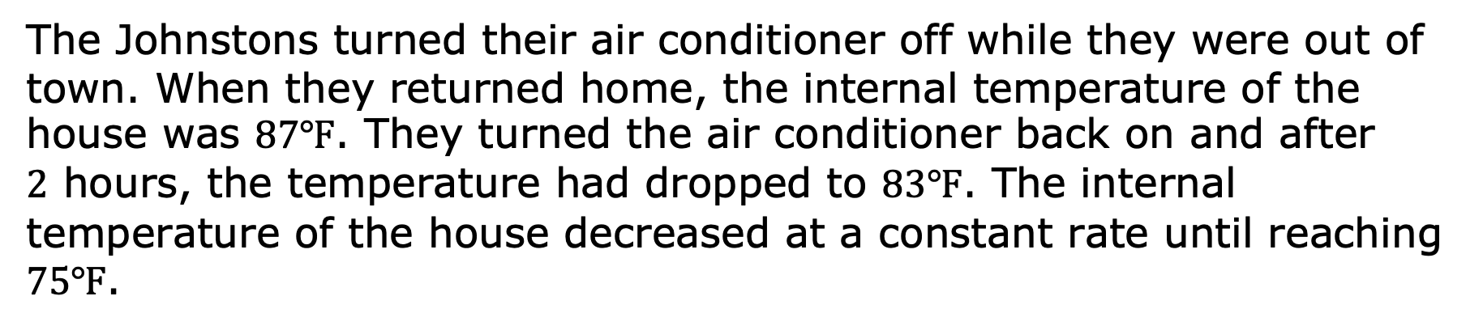
7.5.6 Wrap-Up: Ticket Out the Door
The Johnstons turned their air conditioner off while they were out of town. When they returned home, the internal temperature of the house was $87$℉. They turned the air conditioner back on and after $2$ hours, the temperature had dropped to $83$℉. The internal temperature of the house decreased at a constant rate until reaching $75$℉.
volume 1, pg. 310

Slide 28
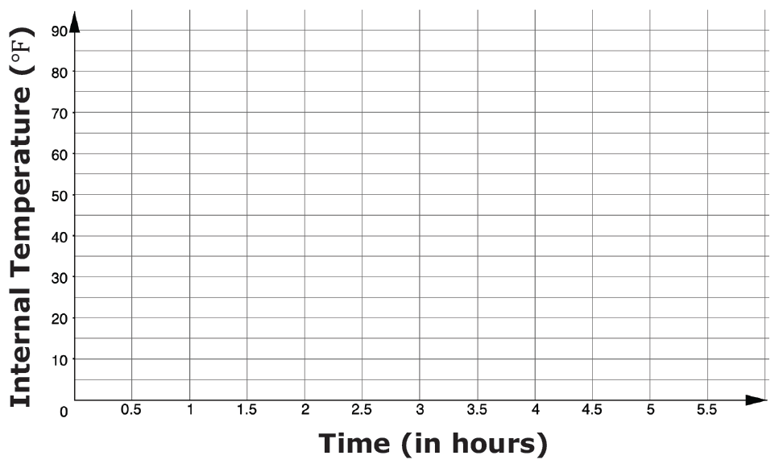
Graph the linear relationship.
volume 1, pg. 310

